Slide 1
A Simple Conceptual Dependency Representation
“I gave the man a book.”
where the symbols have the following meanings:
Arrows indicate direction of dependency.
Double arrow indicates two way link between actor and action.
p indicates past tense.
ATRANS is one of the primitive acts used by the theory. It indicates transfer of possession.
o indicates the object case relation.
R indicates the recipient case relation.

Slide 2
CD Primitive Actions
ATRANS Transfer of an abstract relationship (e.g., give)
PTRANS Transfer of the physical location of an object (e.g., go)
PROPEL Application of physical force to an object (e.g., push)
MOVE Movement of a body part by its owner (e.g., kick)
GRASP Grasping of an object by an actor (e.g., clutch)
INGEST Ingestion of an object by an animal (e.g., eat)
EXPEL Expulsion of something from the body of an animal (e.g., cry)
MTRANS Transfer of mental information (e.g., tell)
MBUILD Building new information out of old (e.g., decide)
SPEAK Production of sounds (e.g., say)
ATTEND Focusing of a sense organ toward a. stimulus (e.g., listen)

Slide 3
CD Primitive Conceptual Categories
ACTs Actions
PPs Objects (picture producers)
AAs Modifiers of actions (action aiders)
PAs Modifiers of PPs (picture aiders)

Slide 4
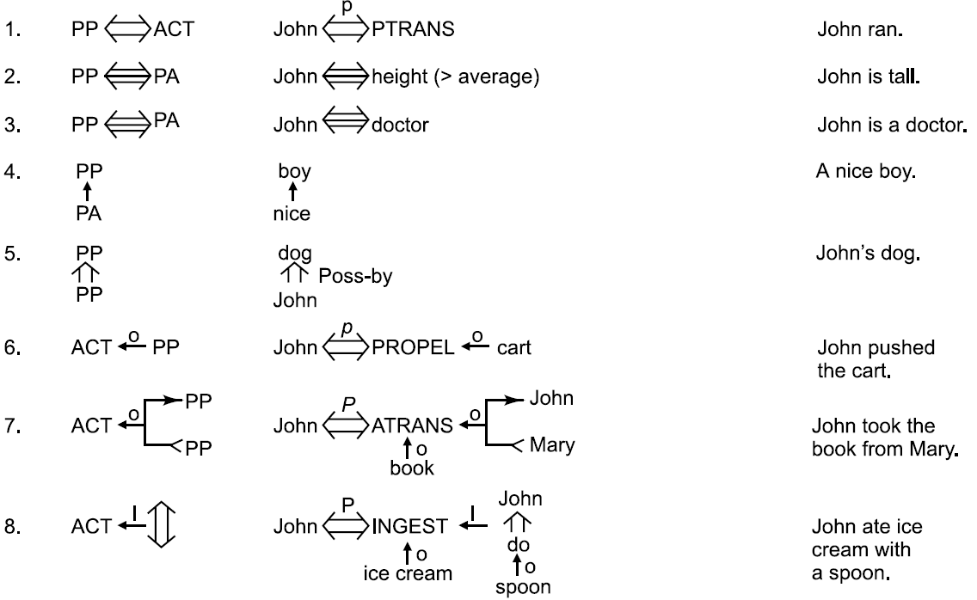
The Dependencies of CD

Slide 5
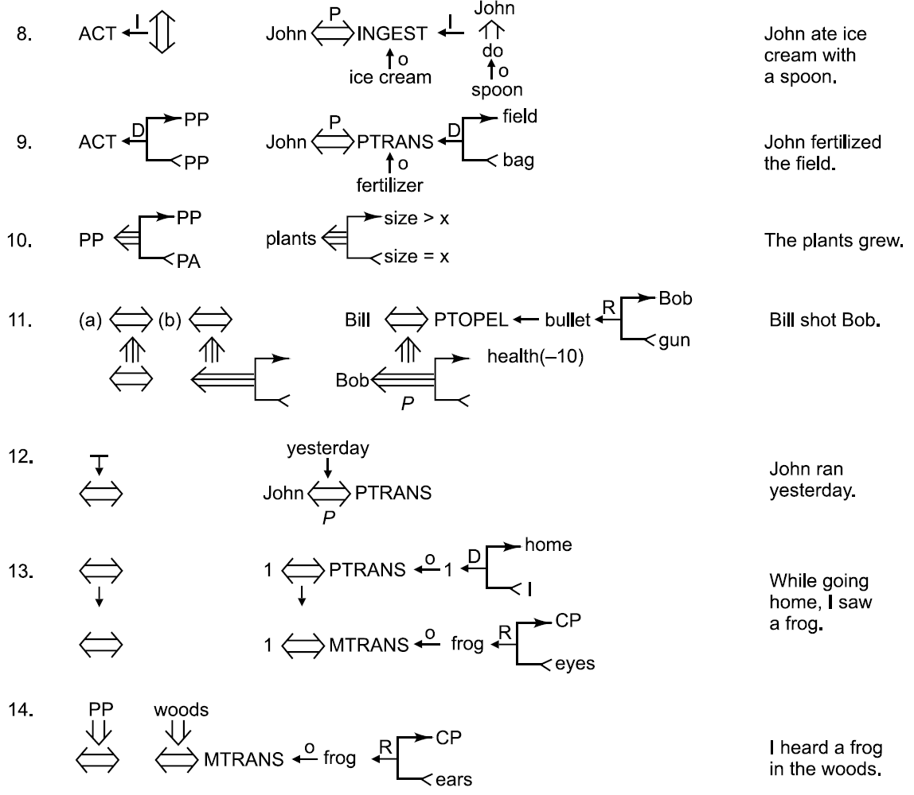
The Dependencies of CD (Cont’d)

Slide 6
CD Conceptual Tenses

Slide 7
Using Conceptual Tenses
“Since smoking can kill you, I stopped.”

Slide 8
The CD Representation of a Threat
“Bill threaten John with a broken nose.”

Slide 9
The Components of a Script
Entry conditions Conditions that must, in general, be satisfied before the events described in the script can occur.
Result Conditions that will, in general, be true after the events described in the script have occurred.
Props Slots representing objects that are involved in the events described in the script. The presence of these objects can be inferred even if they are not mentioned explicitly.
Roles Slots representing people who are involved in the events described in the script. The presence of these people, too, can be inferred even if they are not mentioned explicitly. If specific individuals are mentioned, they can be inserted into the appropriate slots.
Track The specific variation on a more general pattern that is represented by this particular script. Different tracks of the same script will share many but not all components.
Scenes The actual sequences of events that occur. The events are represented in conceptual dependency formalism.

Slide 10
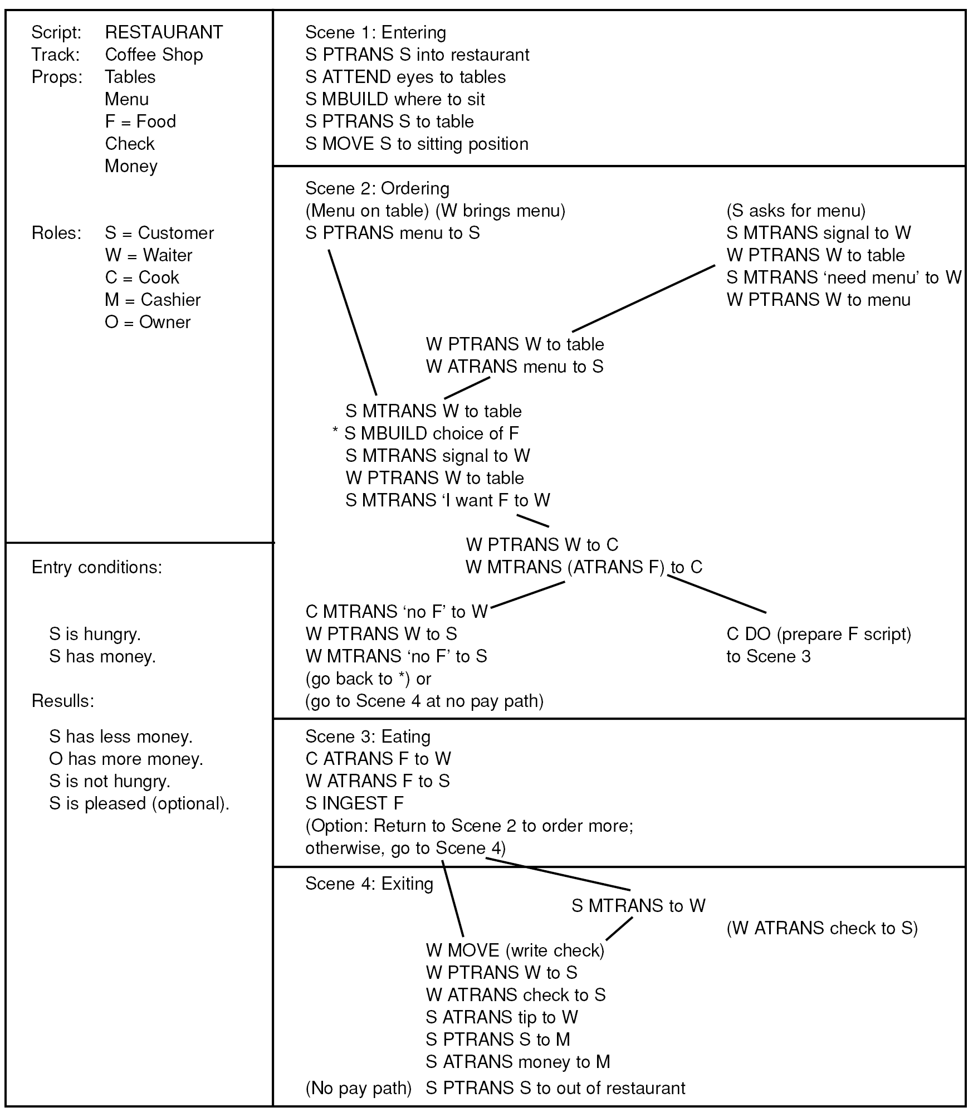
The Restaurant Script

Slide 11
Triggering and Using Scripts
Susan passed her favorite restaurant on her way to the museum. She really enjoyed the new Picasso exhibit.
John went out to a restaurant last night. He ordered steak. When he paid for it, he noticed that he was running out of money. He hurried home since it had started to rain.
Susan went out to lunch. She sat down at a table and called the waitress. The waitress brought her a menu and she ordered hamburger.
John went to a restaurant. He was shown to his table. He ordered a large steak. He sat there and waited for a long time. He got mad and left.

Slide 12
Frames and Constraint Expressions in CYC

